Slide 1
Cosmology and general relativity: the evolution of the universe and the testability of models
George Ellis,
University of Cape Town
Seven Pines Symposium
June 2015

Slide 2
GR and Cosmology
The application of General Relativity to cosmology led to a number of radical new ideas about the nature of the universe,
and also raised some philosophical issues that are still with us today.
Two main themes run through this:
1. the issue of the relation of physics to cosmology,
2. the issue of the testability of theories about the universe in the large.
Underlying this of course is the issue of the uniqueness of the universe.

Slide 3
The major events in the relation of GR to cosmology
Einstein 1917: GR gives cosmological model
Lemaitre 1927: expanding universe cosmology
Lifshitz 1946: perturbations of expanding universe
Sandage 1961: systematic observational tests
Sachs and Wolfe 1967: CMB perturbations
Guth 1980: inflationary universe
Mukhanov and Chibisov 1981: inflationary fluctuations

Slide 4
GR and Cosmology: the issue of the relation of physics to cosmology,
As to the first, on the one hand the physical cosmology picture of an evolution of the universe from a hot big bang to the present day has offered a series of unifications of ever more fundamental physics with cosmological models and predictions;
on the other hand it has led to the spectre of creation of the universe from a state when physics did not apply, or else emergence from a quantum gravity era that we do not understand.

Slide 5
Key feature 1: RW model evolution
Energy conservation equation
dρ/dt + 3H(ρ+p)=0
Friedmann equation:
3H² = κρ + Λ - 3k/a^{2,} where k = +1, 0, -1
Matter plus local gravity everywhere determines space time structure
This determines History of matter e.g. Temperature, density vs time: T(t), ρ(t)
Different Equation of state give different evolution of universe
Tested by many observations

Slide 6
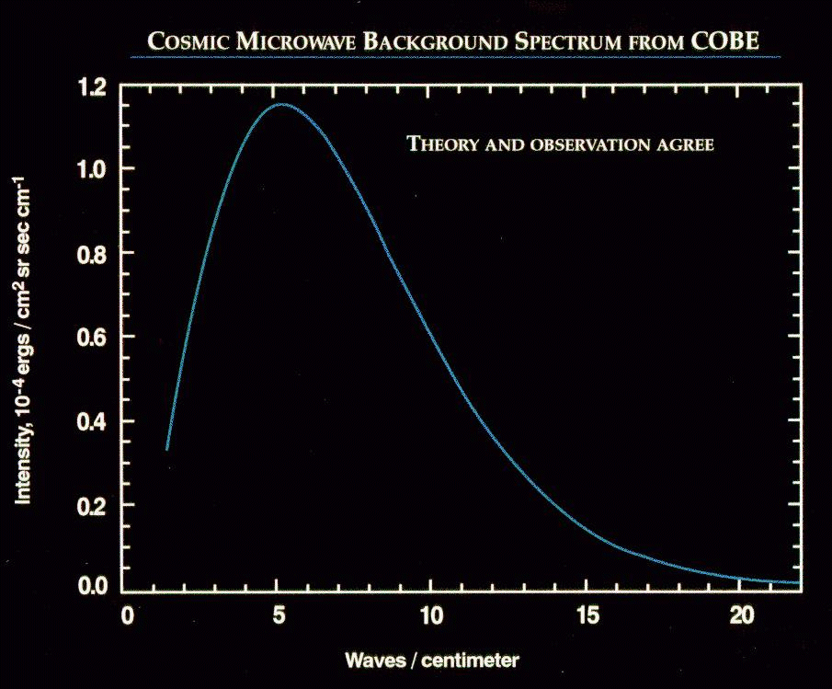
Cosmology slides
Standard QM applies at time
of decoupling

Slide 7
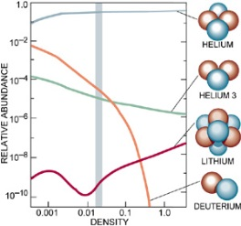
Nucleosynthesis
Standard nuclear
physics applies at time of nucleosynthesis
ρ
Determines density of baryons

Slide 8
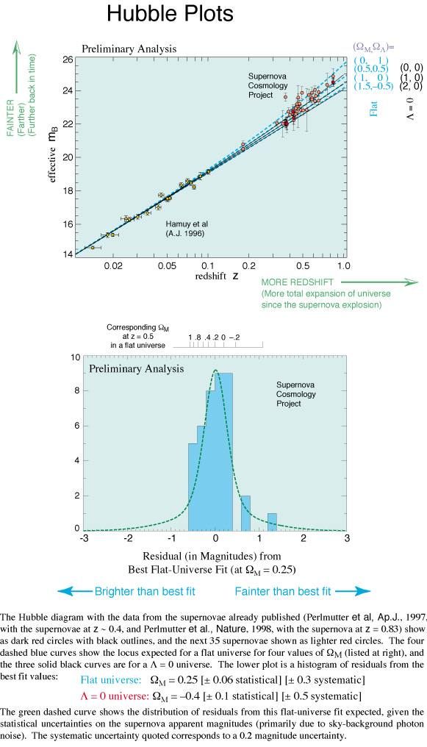
Key set of observations (Nobel prize!)
Decay of supernovae in distant galaxies provides a usable standard candle (maximum brightness is correlated to decay rate)
With redshifts, gives the first reliable detection of non-linearity
- showing the universe is presently accelerating
Consequently there is presently an effective positive
cosmological constant with Ω_{Λ} ~ 0.7: Nature unknown!

Slide 9
Expansion history
time

Slide 10
Relation to physics
Unifications
Gravitation | Universe Expansion Dynamics | Hubble diagram | Apple, moon, universe
Atomic physics | Equilibrium and Decoupling | CBR spectrum | Planck black body, CBR
Nuclear physics | Nucleosynthesis | Element abundances | Nuclear reactors, nucleosynthesis
Particle physics | Inflation | CBR anisotropies | LHC and inflation iff Higgs
Quantum gravity | ?? | ?? | ??
.
True link??
Start?
Bounce?
Emerge?
G Ellis and J-P Uzan: Inflation and the Higgs Particle
Astronomy & Geophyiscs • February 2014 • Vol. 55

Slide 11
The observational context:
Can only observe on past light cone
Here
and now
furthest matter
we can see
Distant galaxy
LSS
Hidden
Start of universe
CMB 2-sphere:
Nucleosynthesis:
Very early past world line

Slide 12
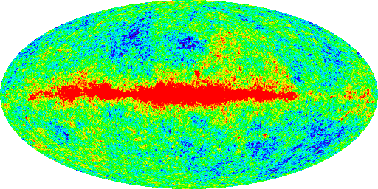
CMB 2-sphere
Can’t see this
matter today
Microwave background radiation anisotropy: dipole removed
Anisotropy at one part in 100,000: primordial fluctuations

Slide 13
GR and Cosmology the testability of theories about the universe in the large.
As to the second, the existence of particle and visual horizons leads to an inherent uncertainty in our models of cosmology on the largest scales
(unless we live in a small universe).
Physicists are straining to say that they can solve issues of geometry beyond the horizon, and the origins of the universe, purely through physics,
but there is a large element of wishful thinking in these claims.

Slide 14
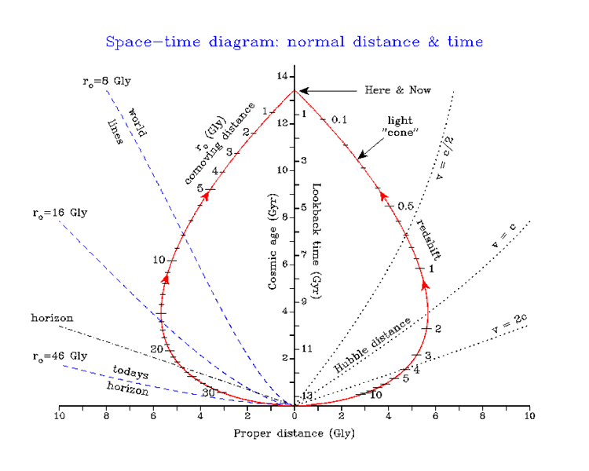
The key observational point is that domains beyond the particle horizon are unobservable.
See the diagrams of our past light cone by Mark Whittle (Virginia)

Slide 15
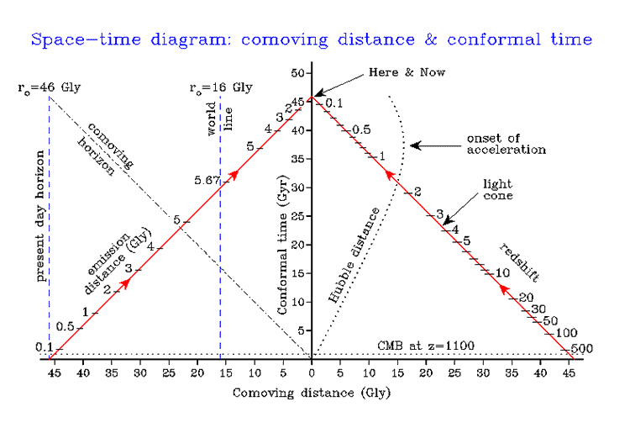
Expand the spatial distances, change to conformal time to see the causal structure (light cones at ±45º)
Visual
Horizon
Observable
LSS
Comoving coordinates
Start of universe

Slide 16
Now it is clear what the observational and causal limits are:
No observational data whatever are available
Better scale:
The assumption often made is we can extrapolate to 100 Hubble radii, 10¹⁰⁰⁰
Hubble radii, or much much more (`infinity’)
You can make any claim you like – it cannot be proved or disporved
Observable universe domain
Extrapolation to unobservable universe domain
Extrapolation to unobservable universe domain
Observable universe domain

Slide 17
So: The Limits
Energies and colliders
7Tev ➔ 15Tev?
Planck energy 2.43 × 10¹⁸ GeV.
Visual and Causal Horizons
Uncertainty Principles
We will have seen all we can see
We will have tested collisions to the highest feasible energies
(physics, astronomy, finance limits)

Slide 18
However one very interesting development has taken place:
it has turned out that our best limitations on cosmological models
come not through observations directly testing spacetime structure,
but rather from observations related to structure formation in the early universe.
This in turn lets us use CMB anisotropy observations to place constraints on particle physics models.
Furthermore, cosmological observations can be used to test deviations from general relativity theory and proposals for alternative theories of gravity.

Slide 19
Key feature 2: Basic structure formation
Linearly Perturbed FLRW models (early times),
plus numerical simulations (later times)
Quantum fluctuations in inflation generate inhomogeneities that seed acoustic waves in HBB era
These produce a pattern of fluctuations on the LSS that are then the seeds for gravitational instability to generate structures
This gives the best tests of inflationary cosmological models

Slide 20
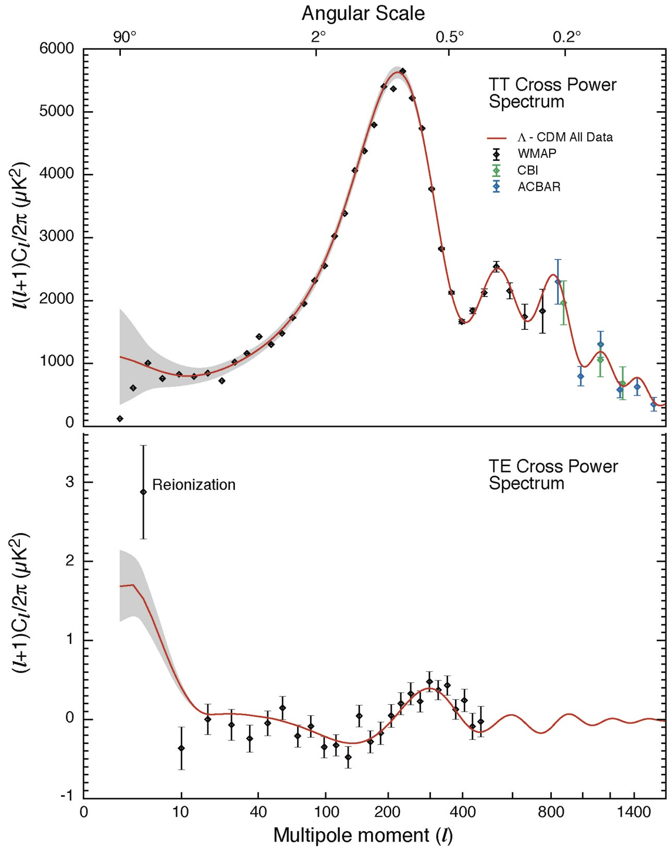
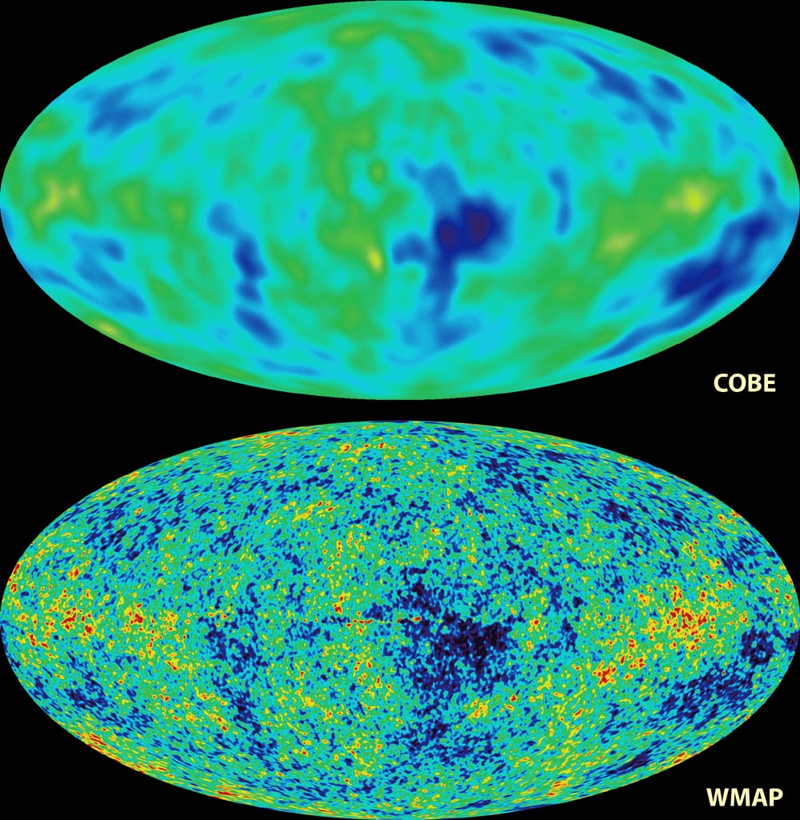
CMB Power spectrum
The dark matter density is
Ω_{m0} ~ 0.3
The cosmological constant is
Ω_{Λ} ~ 0.7
Agrees with lensing and matter power spectrum and velocities

Slide 21
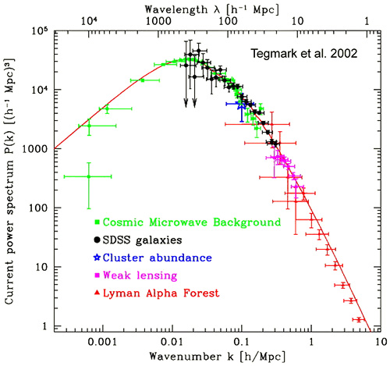
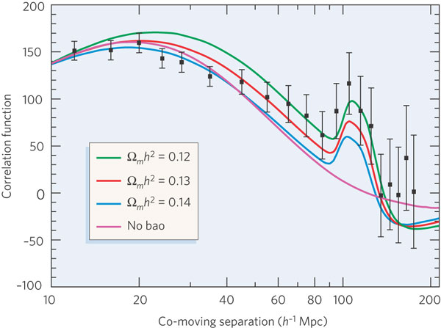
Matter power spectrum, Baryon Acoustic Oscillations
Matter trying to collapse under the influence of gravity vs. radiation
pressure pushing it back out — creates oscillations: sound waves

Slide 22
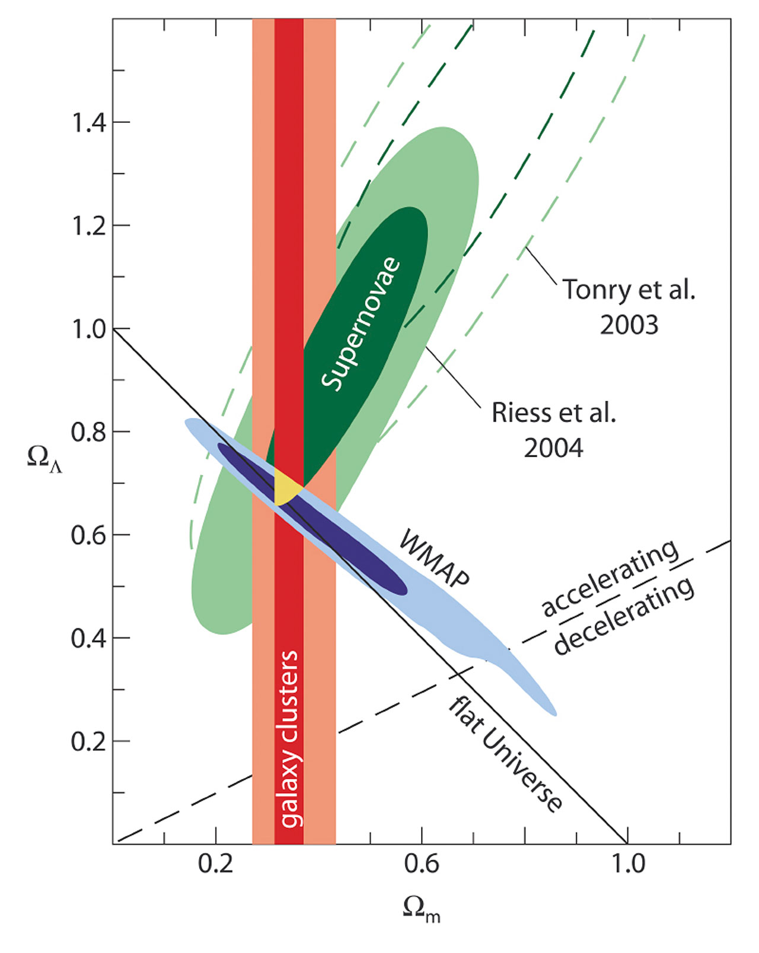
Dark energy and dark matter with an almost flat universe
Structure gives the values

Slide 23
Is “dark energy” a result of inhomogeneity?
THEOREM: The background model can be fitted by an inhomogeneous LTB model for any value of the cosmological constant and for any source evolution
We are at the centre of a large underdesity
BUT
> Integrated Kinematic Sachs-Wolfe effect seem to rule them out

Slide 24
Elements with distance:
Testing the hidden eras
Helium here
and now
Helium abundance
Nucleosynthesis
Nucleosynthesis far out

Slide 25
KSZ test of Copernican Principle:
Here
and now
Scattering event:
Radiation isotropic?
CMB 2-sphere
Probes Interior

Slide 26
Is “dark energy” a result of altered field equations?
Perhaps:
Under intense investigation
BUT
Can we invert the logic, and use cosmological observations to test the validity of GR>
Yes we can.

Slide 27
https://royalsociety.org/events/2011/general-relativity/
Testing general relativity with cosmology
9:00 am on Monday 28 February 2011 — 6:00 pm on Tuesday 01 March 2011 at The Royal Society at Chicheley Hall, Buckinghamshire
If General Relativity holds true then the majority of the Universe’s matter is exotic and unknown. With current developments in theoretical physics, alternatives to Einstein’s theory have begun to emerge. Furthermore, the coming decade promises wide-ranging, cutting edge experiments on cosmic scales. For the first time in almost a century we will begin to test Einstein’s theory and its rivals by comparing them to our ever more precise understanding of the Universe.

Slide 28
Testing general relativity with cosmology
Day 1 – Monday 28 February 2011
Rachel Bean, Cornell : Constraining the cosmic growth history with large scale structure
Edmund Bertschinger, MIT: One gravitational potential or two? Forecasts and tests
Constantinos Skordis, Nottingham: Cosmological tests of gravity
Thomas Kitching, Edinburgh: Testing modified gravity with next generation weak lensing experiments
Eric Linder, Berkeley: Model independent tests of cosmic gravity
Jean-Philippe Uzan, IAP, Paris: Testing general relativity: from local to cosmological scales
Fabian Schmidt, CalTech: Probing gravity in the non-linear regime of large-scale structure
Ruth Durrer, Geneva: What do we really know about dark energy?
Will Percival: Redshift-space distortions

Slide 29
Testing general relativity with cosmology
Day 2 – Tuesday 1 March 2011
Jacob Bekenstein, Jerusalem: Tensor-vector-scalar modified gravity: from small scale to cosmology
Glenn Starkman, Case Western Reserve University: Modifying gravity: you can't always get what you want
Roy Maartens, University of Western Cape: Is the universe homogeneous?
Pengjie Zhang, Shanghai : Confirmation of the Copernican principle at Gpc radial scale and above
Bhuvnesh Jain, University of Pennsylvania: Cosmological tests with upcoming lensing and spectroscopic surveys
Robert Caldwell, Dartmouth College: A gravitational puzzle

Slide 30
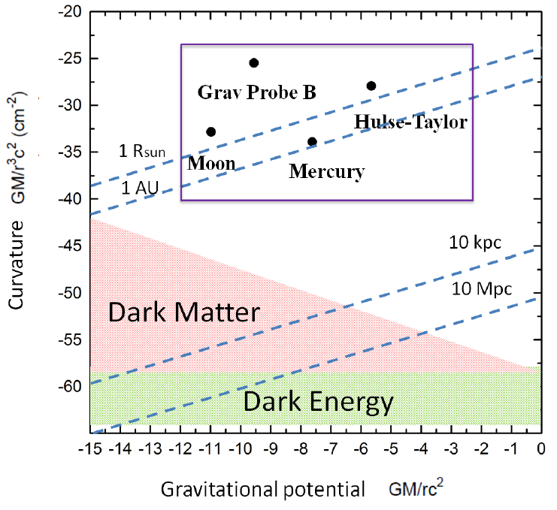
Over the next five years, a number of vast astronomical surveys of the galaxy distribution are underway, such as Dark Energy Survey (DES, 2012-2017), extended Baryon Oscillation Spectroscopic Survey (eBOSS, 2014-) and Mapping Nearby Galaxies at APO (MaNGA, 2014-). Future surveys such as ESA’s Euclid mission provide an opportunity to perform ultimate tests of gravity on the largest scales in our Universe
Tests of General Relativity on various scales. The vertical axis is the spacetime curvature and the horizontal axis is the gravitational potential. The blue dotted lines indicate typical length scales.
GR is well tested at solar system scales and also by binary pulsars (within the purple box). However, outside this region, gravity is not tested by conventional methods.
Modified from Psaltis arXiv:0806.1531.
http://www.icg.port.ac.uk/cosmological-tests-of-gravity/

Slide 31
Addendum 1: Effective domain of dependence
Matter here
and now
Physical Horizon
The part of the universe that actually affects us is a comoving sphere of R_{ph} = 1Mpc
[Ellis and Stoeger: arXiv 101.4572] All outside is irrelevant.

Slide 32
Addendum 2: The key unsolved issue
Quantum fluctuations
Classical Fluctuations
1. Decoherence? no
2. Collapse? (Sudarsky et al)
2. Pilot wave? (Bohm)

Slide 33
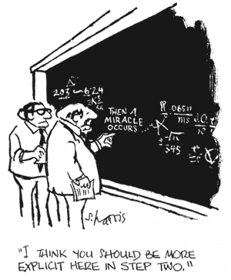
So how does the quantum to classical transition take place?

